Slide 1
OWC RSS with ML Enhancements Experimental Setup, Measurements and Localisation Results
by Ali Mahbas and John Cosmas

Slide 2
Experimental OWC Localisation Setup
Uplink optical wireless localisation using four ceiling-mounted optical antennas (OAs).
OAs arranged in a 1.27 m × 1.27 m square configuration.
A mobile optical transmitter represents the UE and is positioned automatically using a CNC positioning platform.
Signals from all four OAs are acquired simultaneously using an Ettus USRP X310.
At each UE location, 100,000 complex I/Q samples per OA are recorded.
729 measurement locations were used for channel calibration and ML model development.
50 independently acquired UE locations were reserved for final localisation testing.
The independent test locations were not used for fitting the corrected physical model or training the ML models.

Slide 3
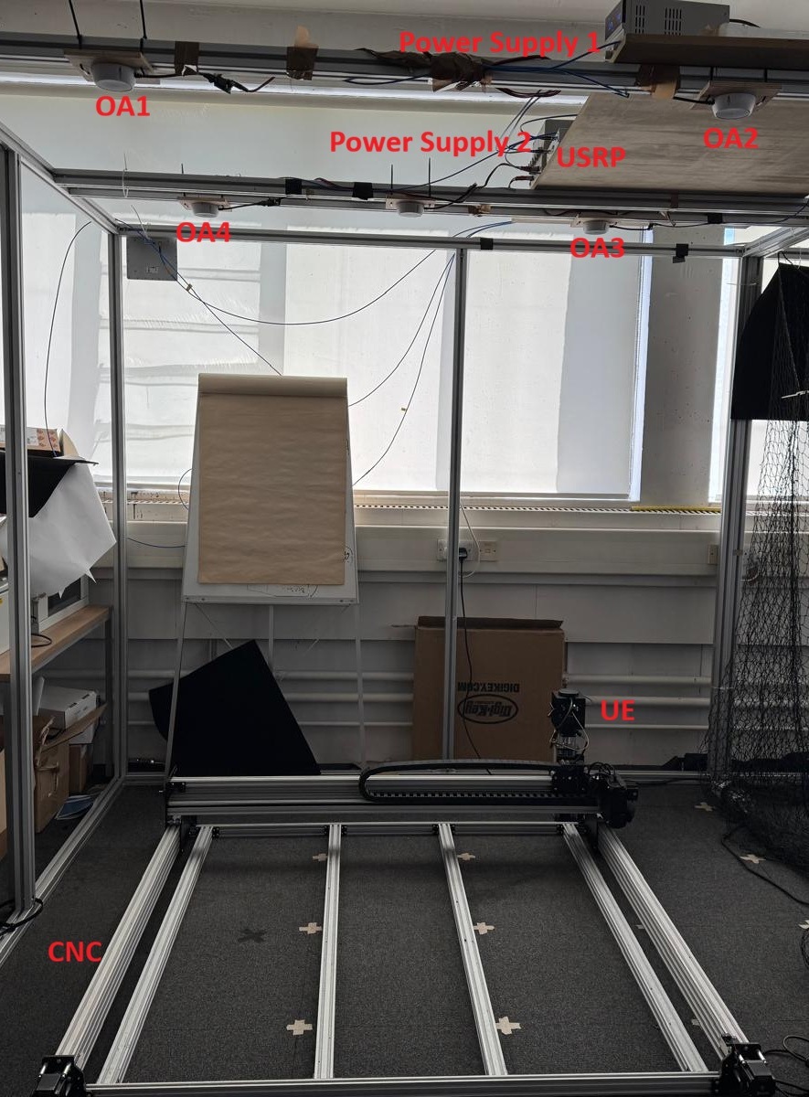
Experimental OWC Localisation Setup
Uplink optical wireless localisation using four ceiling-mounted optical antennas (OAs).
OAs arranged in a 1.27 m × 1.27 m square configuration.
A mobile optical transmitter represents the UE and is positioned automatically using a CNC positioning platform.
Signals from all four OAs are acquired simultaneously using an Ettus USRP X310.
At each UE location, 100,000 complex I/Q samples per OA are recorded.
729 measurement locations were used for channel calibration and ML model development.
50 independently acquired UE locations were reserved for final localisation testing.
The independent test locations were not used for fitting the corrected physical model or training the ML models.

Slide 4
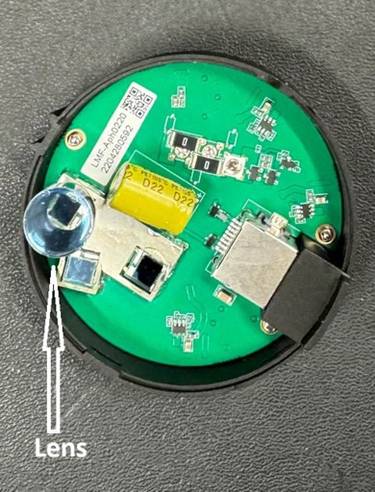
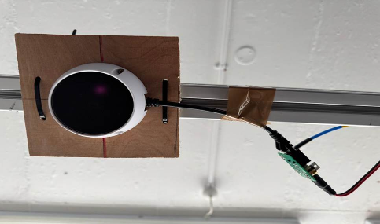
OPTICAL Transmitter and Receiver
Transmitter Receiver
IR LED
IR Sensor
Optical Antenna
Optical Conversion Board

Slide 5
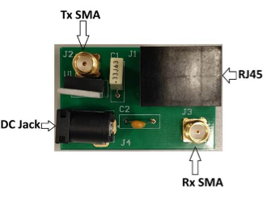
Optical Conversion Board at Transmitters and Receivers
The conversion board serves as the central electrical interface within the experimental platform.
During transmission, the modulation signal generated by the portable signal generator is applied to the transmit SMA connector, conditioned by the conversion board and forwarded to the optical antenna through the RJ45 interface. Antenna simultaneously receives its operating power from the same board.
During reception, the optical antenna converts the incident infrared radiation into an analogue electrical signal, which is routed back through the RJ45 connection to the receive SMA connector before being digitised by the USRP X310.
Every transmitted and received signal within the experimental platform passes through the conversion board, making it an essential component of both the transmitter and receiver signal chains.

Slide 6
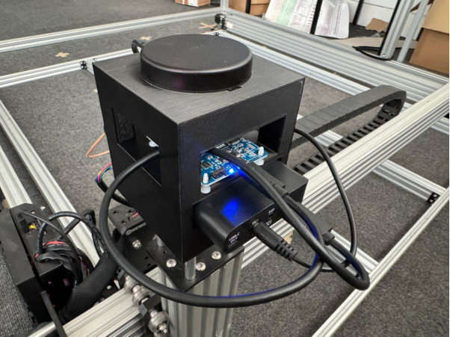
OWC User Equipment
A dedicated enclosure was designed specifically for this project and manufactured using a 3D printer
The enclosure contains:
  optical antenna (OA);
  portable signal generator;
  rechargeable power bank providing both 5 V and 24 V power supplies;
  necessary interconnecting cables and connectors.
Optical Antenna
Portable Signal
Generator
Rechargeable
Power Bank

Slide 7
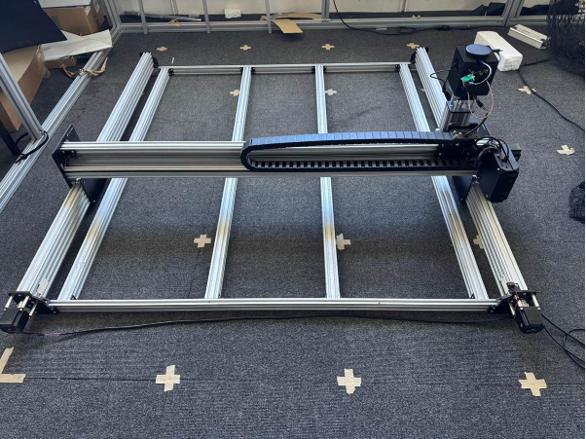
Automated Positioning System
To automate the data collection process, the experimental setup incorporates a three-axis Cartesian positioning system based on an Ooznest WorkBee Z1+ CNC platform.
The system consists of a 1500 × 1500 mm aluminium extrusion frame driven by a Duet3D motion controller.
Rather than using the CNC machine for manufacturing, the spindle assembly has been replaced with a custom-designed fixture that securely holds the UE.
This configuration transforms the CNC machine into a high-precision automated positioning system capable of moving the UE accurately within the measurement area.
The active measurement area is approximately 1270 × 1270 mm in the horizontal plane with 88 mm of vertical travel. The positioning system is controlled remotely using standard G-code commands transmitted via an Ethernet connection.
During an experiment, the administration computer automatically generates the required G-code commands and sequentially moves the UE to each predefined measurement location.
This automation eliminates the need for manual positioning, significantly improves repeatability, and enables large measurement campaigns to be completed with minimal human intervention. The positioning accuracy is within a millimetre, allowing reliable mapping of received optical signal characteristics throughout the entire measurement area.

Slide 8
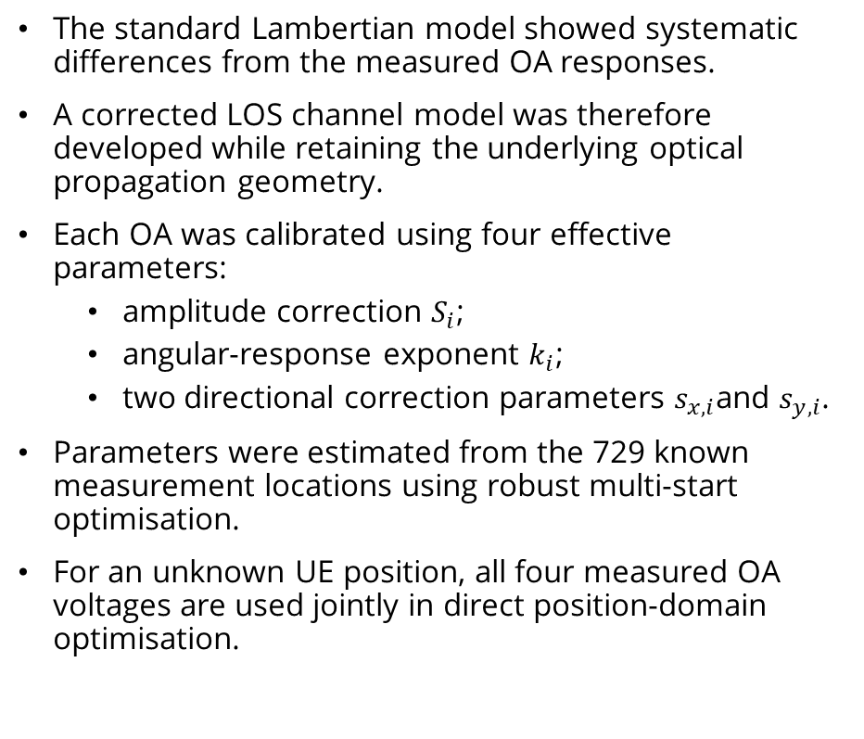
Corrected Physical Model and Localisation Results
Metric | Corrected Model | % of 1270 mm side | Interpretation
Mean 2-D error | 21.88 mm | 1.72% | Average positioning error
Median 2-D error | 20.73 mm | 1.63% | Typical positioning error
RMSE | 25.67 mm | 2.02% | Error magnitude, emphasising larger errors
P90 2-D error | 37.66 mm | 2.97% | 90% of estimates fall below this error
Maximum error | 72.35 mm | 5.70% | Worst observed test-location error
The standard Lambertian model showed systematic differences from the measured OA responses.
A corrected LOS channel model was therefore developed while retaining the underlying optical propagation geometry.
Each OA was calibrated using four effective parameters:
  amplitude correction $S_{i}$;
  angular-response exponent $k_{i}$;
  two directional correction parameters $s_{x,i}$and $s_{y,i}$.
Parameters were estimated from the 729 known measurement locations using robust multi-start optimisation.
For an unknown UE position, all four measured OA voltages are used jointly in direct position-domain optimisation.

Slide 9
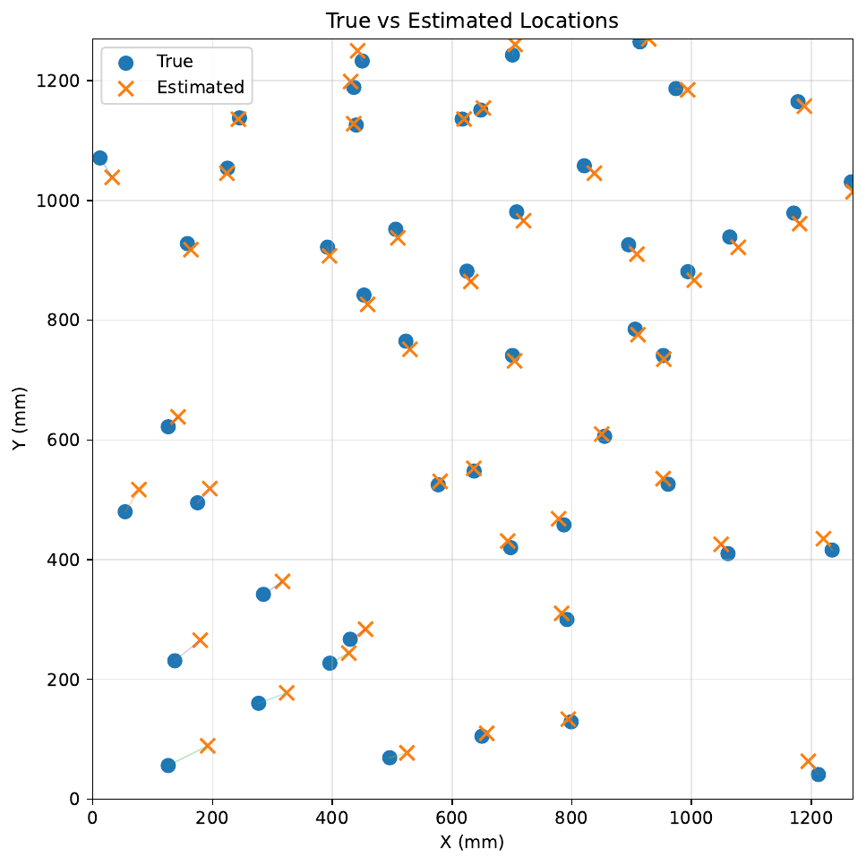

Slide 10
Data-Driven Localization Using Machine Learning
Metric | Observed value | % of 1270 mm side | Interpretation
Mean 2-D error | 6.50 mm | 0.51% | Average positioning error
Median 2-D error | 4.41 mm | 0.35% | Typical positioning error
P90 2-D error | 14.02 mm | 1.10% | 90% of estimates fall below this error
Maximum error | 24.92 mm | 1.96% | Worst observed test-location error
ML provides a complementary approach that learns the relationship between the four-OA measurements and UE position directly.
RSS, received voltage and electrical power were investigated as input representations.
12 regression approaches were evaluated, including linear, polynomial, kernel, tree-based and neural-network models.
Feature sets and model hyperparameters were selected using the 729 development measurements.
Final performance was evaluated using the same 50 independent test locations.
The best model was Polynomial + Ridge using RSS + Power from the four OAs.
The model uses eight original signal features and a degree-3 interaction-only polynomial representation with Ridge regularization.

Slide 11
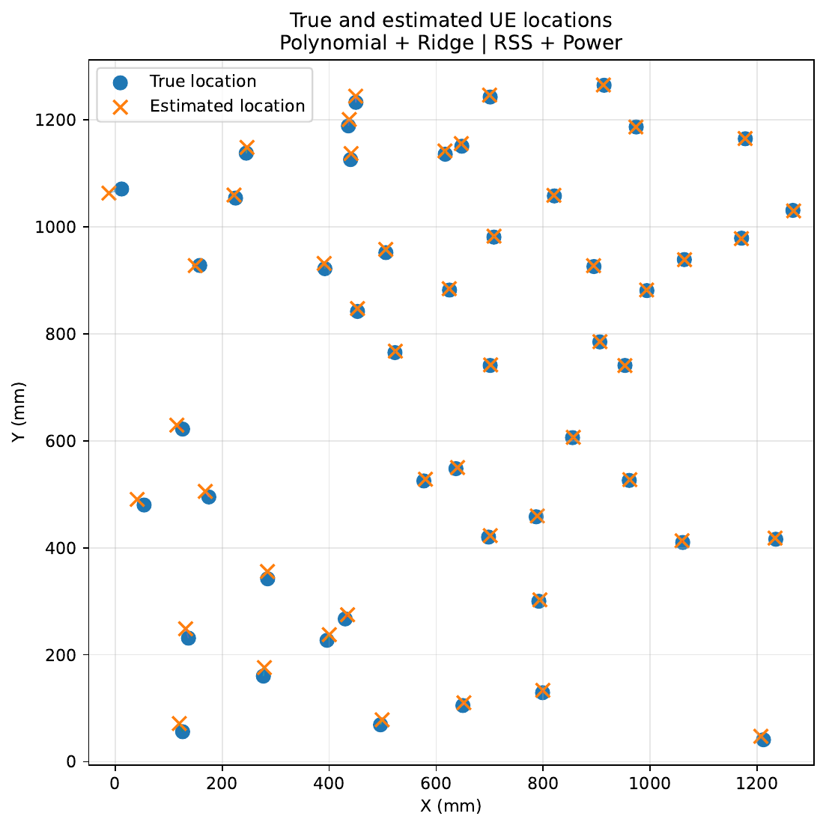

Slide 12
Main Results and Comparison
The standard Lambertian model is strongly affected by practical OA/channel non-idealities.
The corrected physical model reduces these systematic effects while retaining physical interpretability.
ML achieves the highest localization accuracy, exploiting the complete repeatable four-OA signal pattern.
The two approaches are complementary: physical model → interpretability; ML → maximum measured accuracy.
Method | Mean | Median | RMSE | P90
Standard Lambertian | 393 mm | 412 mm | 420 mm | 571 mm
Corrected Physical Model | 21.88 mm | 20.73 mm | 25.67 mm | 37.66 mm
Best ML – Polynomial + Ridge | 6.50 mm | 4.41 mm | 8.63 mm | 14.02 mm

Slide 13
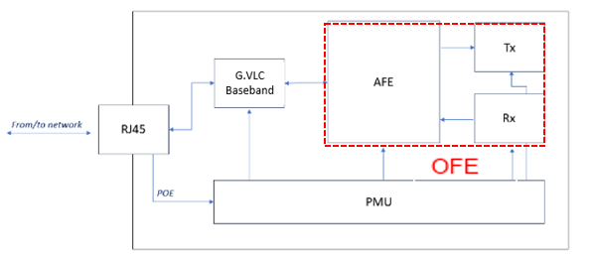
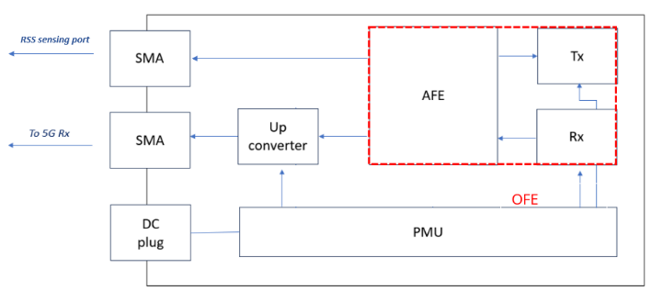
Adaptation of LiFI OWC Antenna to 5G OWC Antenna
The OWC system 5G building blocks have been adapted from baseband part of an existing G.vlc WiFi system.
The G.vlc baseband and the PHY Ethernet has been replaced by an up/down converter (using an An RF mixer) to allow using OWC to interface with the 5G network.
ADAPTATION

Slide 14
Integration of 5G OWC Antenna for OPTI-6G Cellfree Test
NIB
Network in a Box (Core + CU + DU)
and
Localisation Server
RADIO
UNIT
3.5GHz
Commercial UE
3.5GHz
ORAN
Option
7.2
UC
Optical Rx
C
INTERNET
5
DC
Optical Tx
Optical Tx
DC
C
ORAN
Option
7.2
RADIO
UNIT
3.5GHz
Optical Rx
UC
Optical Rx
UC
C
5
DC
Optical Tx
5
Attenuator 5dB
C
Circulator 3.5GHz
DC
Downconverter from 3.5GHz to 50Mhz
UC
Upconverter from 50 MHz to 3.5 GHz

Slide 15
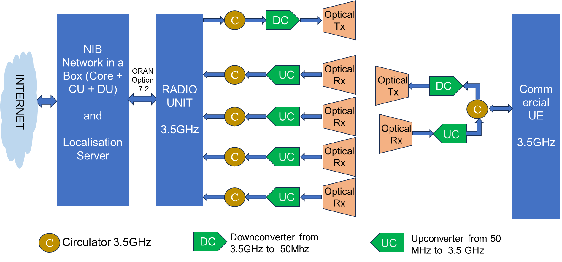
Integration of 5G OWC Antenna for OPTI-6G Localisation Tests
Perform uplink RSS and TDoA localisation accuracy tests on 5G OWC system.
Delay in the design and manufacture of Up/down Converters

Slide 16

Thank you for your attention!
https://opti-6g.sns-ju.eu/

